Slide 2
INTRODUCTION
In today's dynamic educational landscape, schools, colleges, and universities are increasingly turning to technology to streamline their administrative tasks, enhance communication, and improve overall efficiency. One of the cornerstones of this technological transformation is the School Management System (SMS). A School Management System is a comprehensive software solution designed to automate and optimize various aspects of educational institution management.
The School Management System encompasses a wide array of functionalities, including but not limited to student information management, attendance tracking, academic records management, examination and grading, fee collection, library management, communication tools, and reporting and analytics. These features collectively contribute to the effective operation of educational institutions, ensuring that students receive the best possible educational experience, teachers can focus more on teaching, and administrators can make data-driven decisions.

Slide 3
OBJECTIVE
The primary objectives of a School Management System (SMS) are to streamline and enhance the management and operations of educational institutions. These objectives aim to improve efficiency, communication, and decision-making within schools, colleges, and universities. Here are the key objectives of implementing a School Management System:
- Develop a robust and user-friendly SMS.
- Provide support for student enrollment, attendance tracking, and grade management.
- Offer features for teacher assignments, parent communication, and class scheduling.
- Implement a secure and customizable system.
- Ensure scalability for schools of various sizes.

Slide 4
H\W S\W REQUIREMENTS
Hardware
Laptop or pc
Ram 8GB or higher
100GB ROM or higher
This system aims to replace manual, paper-based record-keeping with an efficient and user-friendly digital solution, ultimately enhancing the overall educational experience for students, admin
Software
Windows 10 or above
C and C++
MySQL
Vs code and xampp

Slide 5
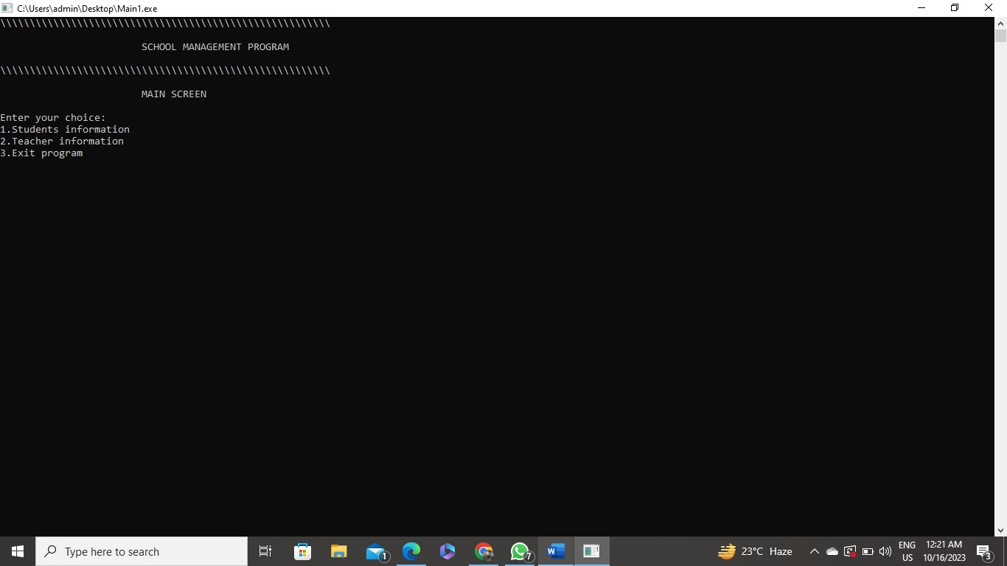
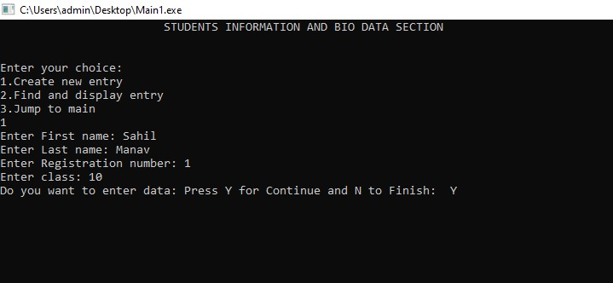
OUTPUTS

Slide 6
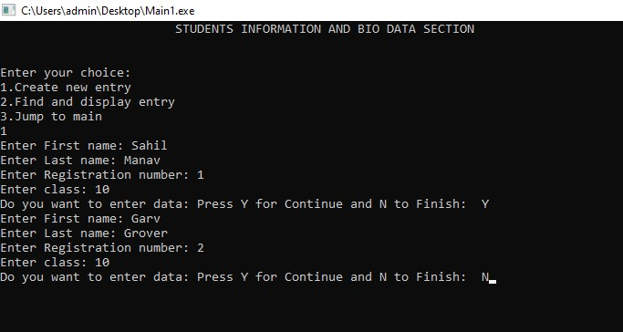
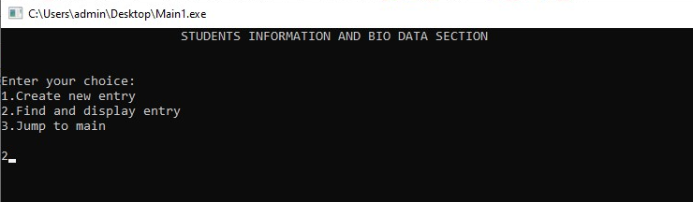

Slide 7
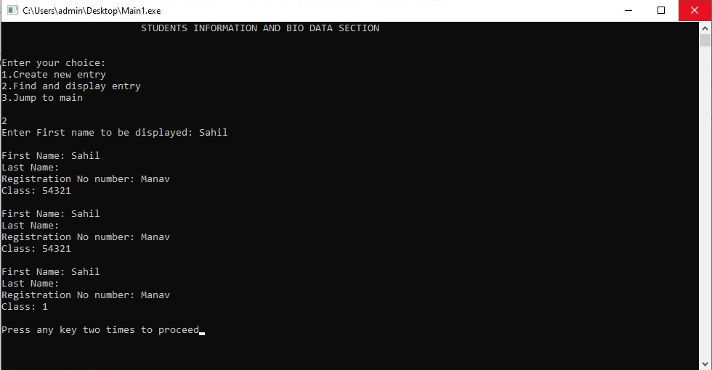

Slide 8
CONCLUSION
The culmination of the School Management System project marks a significant milestone in our ongoing efforts to modernize and enhance the efficiency of our educational institution's administrative processes. As we reflect on the journey from project inception to implementation, several key takeaways and achievements come to the forefront.
First and foremost, the School Management System has brought about a transformative shift in how we manage our school's operations. It has replaced labor-intensive manual tasks with automated processes, offering a comprehensive and centralized platform for administrators, teachers, parents, and students. This has not only reduced the administrative burden but also empowered all stakeholders with real-time access to critical information.

Slide 9
FUTURE SCOPE
The future scope of a school management system project holds great potential for innovation and improvement in the education sector. Here's a narrative description of the possible developments and opportunities:
In the coming years, school management systems are expected to undergo significant transformations as they adapt to the evolving needs of educational institutions. These systems will continue to serve as the backbone of administrative and academic processes, but they will do so with enhanced capabilities and a more user-centric approach.
One of the most promising aspects of the future of school management systems is their integration with cutting-edge technologies. Artificial intelligence (AI) and machine learning will become integral components, allowing these systems to analyze vast amounts of data to predict student performance, identify areas for improvement, and provide personalized learning recommendations. Educators will have access to powerful tools that help them tailor their teaching methods to individual student needs, ultimately leading to better educational outcomes.

